Slide 1
The Regressionalists I-VSCFY
Dr. Siba panda, siba.panda@nmims.edu
Harsh Gupta, Riddhi Mehta, Sidh Satam

Slide 2
Problem Statement 1

Slide 3
Approach
- Source and Nature of data (slides 4 – 7)
- Pre-processing approach (slide 8)
- Technology used (slides 9 – 14)

Slide 4
Source of Data
We chose to make our own textual dataset consisting of sentences.
These sentences are cover maximum possibilities of the conversation between the client and the agent.
The model will hence, be trained on the best combinations of sentences of all categories.
During speech to text conversion, there is a lot of information loss, which has been eliminated by constructing our own sentences.
We have made sure that there is no higher degree class imbalance, hence the 5 categories contain on an average 60 sentences.
So we have a training set of 300 sentences.

Slide 5
Source of Data
Sample audio files were generated which consisted of the real life conversation between a client and an agent focusing on specific category.
These audio files were used as our testing dataset.
The audio was converted using Google Cloud Speech-to-Text and the transcripts were fed into prediction model to calculate accuracy.

Slide 6
Nature of Data
The sentences are in a CSV format organised as shown below:
sentence | label
i am stuck at highway and the car engine is not starting | breakdown
my car works perfectly after servicing thank you | feedback
what documents are required to take the test drive | testdrive
when is the launch of the new model of renault kwid | vehicle_enquiry
the leather seats have started wearing off within one year of purchase | vehicle_quality

Slide 7
Nature of Data
The testing audio files that were generated were in the form of .wav file.
These files were used to convert speech to text and use the output in the prediction model to give the different probabilities of every category.
The probability which was the highest was finally the category the conversation was classified into.

Slide 8
Pre-Processing Approach
Since, we are working with our own dataset, we made sure that there was less pre-processing to carry out.
Although, we converted all the sentences to lower case.
We removed all possible special characters like [/(){}\[\]\|@,;] [^0-9a-z #+_] with a space since they are noise in our data.

Slide 9
Solution Architecture
The CNN was used to train on 391 samples and validate on 98 samples.
This is with respect to the sentences.
The converted speech to text from audio files was used to predict its category as well.
The accuracy on the training model is 96.5%.
We observe that the testing accuracy on the validation set was 79.3%.

Slide 10
Solution Architecture
When the same model was applied onto the transcripts generated by the Speech to Text API, we get the following accuracy table:
Accuracy = 4/5 = 80%
Audio File | Actual Category | Predicted Category
1 | New Vehicle Enquiry | New Vehicle Enquiry
2 | Breakdown | Breakdown
3 | Feedback | Test Drive
4 | Test Drive | Test Drive
5 | Vehicle Quality | Vehicle Quality

Slide 11
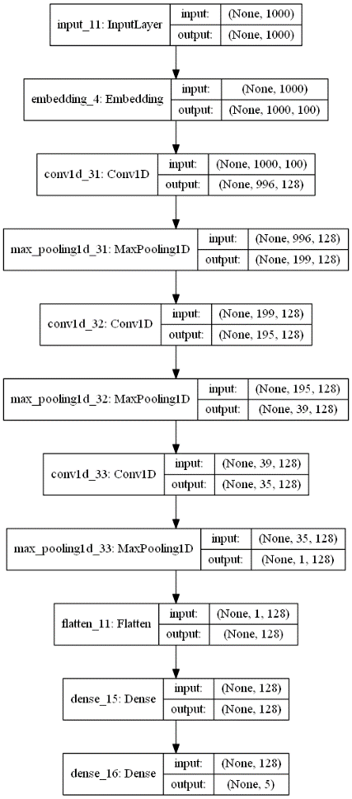


Slide 12
Flow of code
Preprocessing of data
Conversion of textual data to numeric data using tokenizer
Conversion of labels from strings to categorical label in numeric format
Padding sequence is implemented to convert the training dataset to a balanced data which is a vector of length 1000 characters
Train test split is applied using stratified splitting
Word embedding is used to reduce the number of features (similar to PCA)
A simple convolutional neural network is applied using “relu” activation and “rmsprop” optimizer

Slide 13
Flow of code
After having the best model, we call the API to run on the audio file
A text transcript is generated with respect to the audio file.
The paragraph is processed into a smaller sentence with only the important words taken on the basis of a user defined word bank.
The processed sentence is used to predict the final category.

Slide 14
Training Methodology
As mentioned above, we have used our textual dataset as training model.
It has been divided into training, validation set.
The idea behind using direct sentences is to make our model more robust and lesser prone to information loss.
It worked with the following accuracies:
1. Training set – 96.5%
2. Validation set – 79.3%

Slide 15
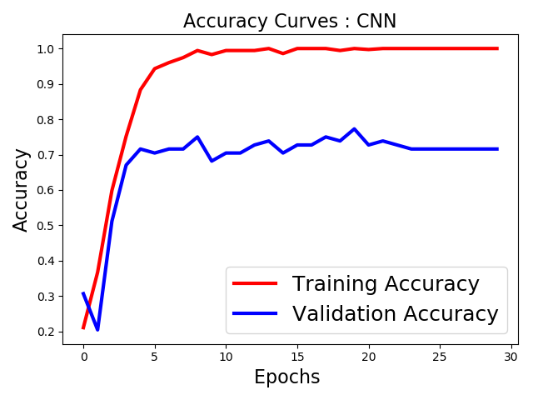
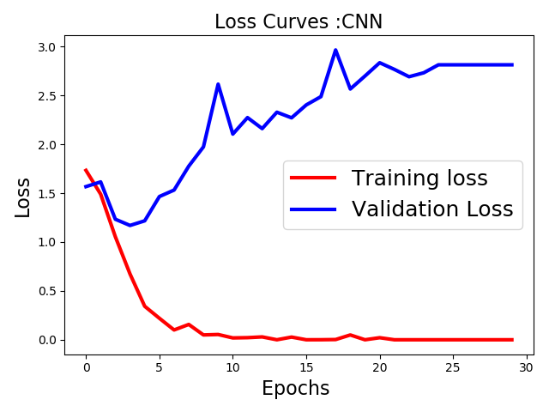
Neural Network Loss and Accuracy Curves

Slide 16
Testing Methodology & Accuracy attained during testing
As mentioned above, we have used API to convert speech to text.
The transcript has been broken down into individual sentences which is fed into the prediction model.
The mode of the category of each audio file is chosen to be the final category of the audio file.
This has been compared to the actual category of the audio file.
We observe that 4 audio test files have been correctly categorized. Hence, we get an testing accuracy of 4/5 = 80%.

Slide 17

Audio File and its Transcript – one example
← Please play this audio file
"hello how can I help you I would like information on purchasing a new vehicle I am looking for a truck in tent and Catering is I am from which place in East Guwahati you have any specific reason that you are aware of give me the address where you stay Road number 5 please put your call on hold yes I am close to your place it's so I will reconnect this qualification and you should be getting a call from the same in today ok thank you thank you "

Slide 18
Summary
In short, we observed and learnt that it was a better approach to use textual data to train the model and then use the converted speech to text from audio files to predict.
Moreover, in the current scenario running a model directly on speech is not feasible. And the current API’s are not very accurate enough to convert every word spoken into text.

